Slide 1
Be Part of Travel
Careers in Travel

Slide 2
Agenda
#BePartofTravel with a career in the travel industry
What is the UK outbound travel industry?
About ABTA – The Travel Trade Association
Why work in the travel industry?
Career options in the travel industry
Education and career development
Resources for students
Travel advice

Slide 3

Notes:
You can inform students to visit the ABTA website to discover careers in travel.
ABTA members may want to download these visual assets from the member zone marketing toolkits.

Slide 4

What is the UK outbound travel industry?
Report 2024-2025
Notes:
The next few slides outline what the UK Travel industry is, the size and economic contribution.

Slide 5
The UK Outbound Travel Industry
Food and Drink Services
Accommodation (Hotels & Villas)
Leisure / Business Travel
Meetings & Events
Notes:
The travel and tourism sector comprises a wide range of products and services, including
leisure and business travel forms the largest part of the industry and comprises of….
Accommodation:
food and drink services,
Aviation – airlines, airports, security
Some of the key markets related to these industries are
hotels, villa rentals,
cruises,
Business - meetings and events, and
travel agencies and tour operators

Slide 6
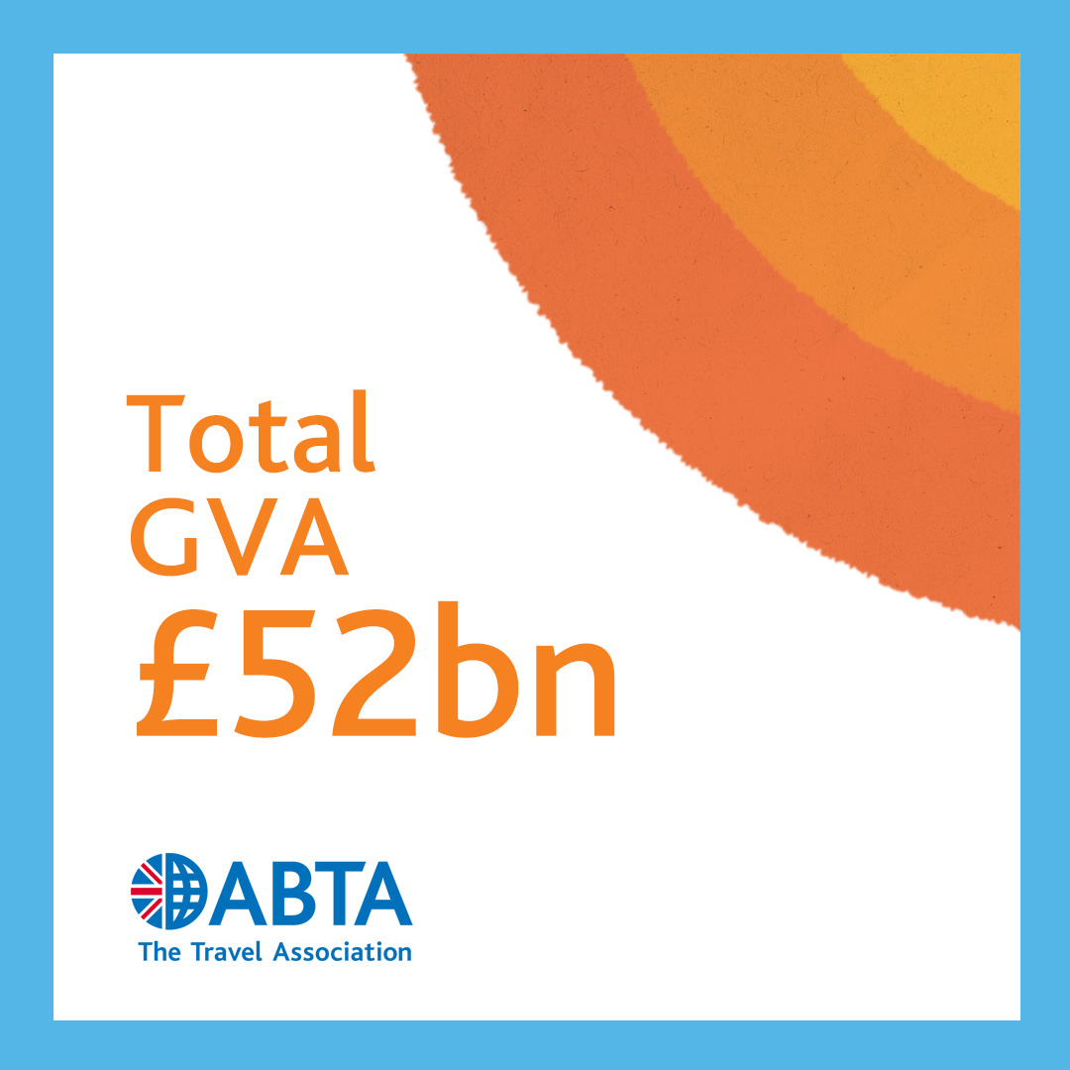
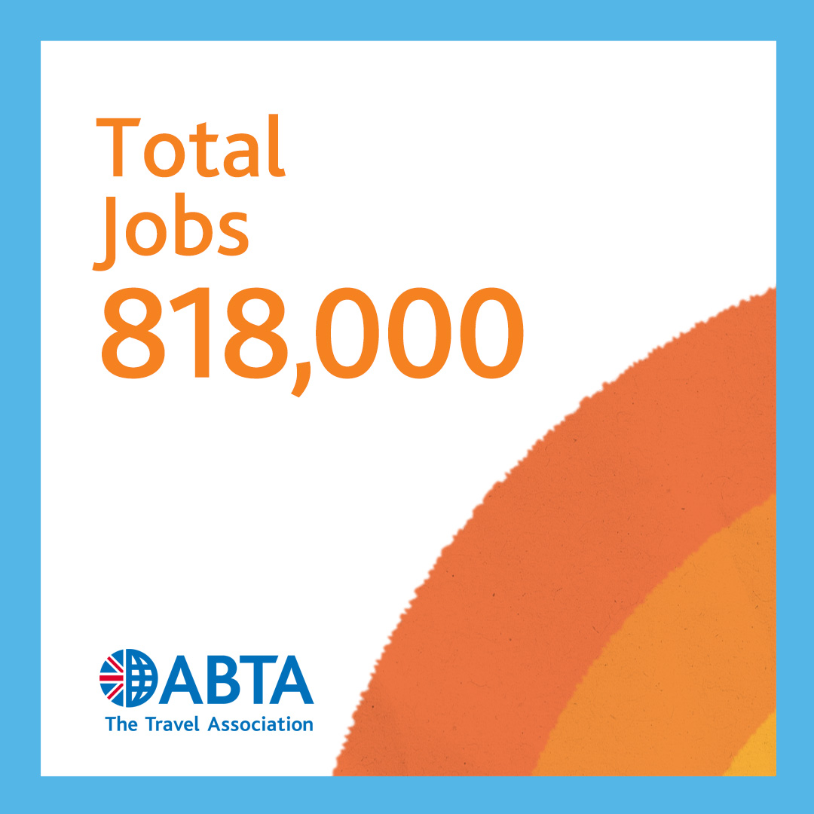
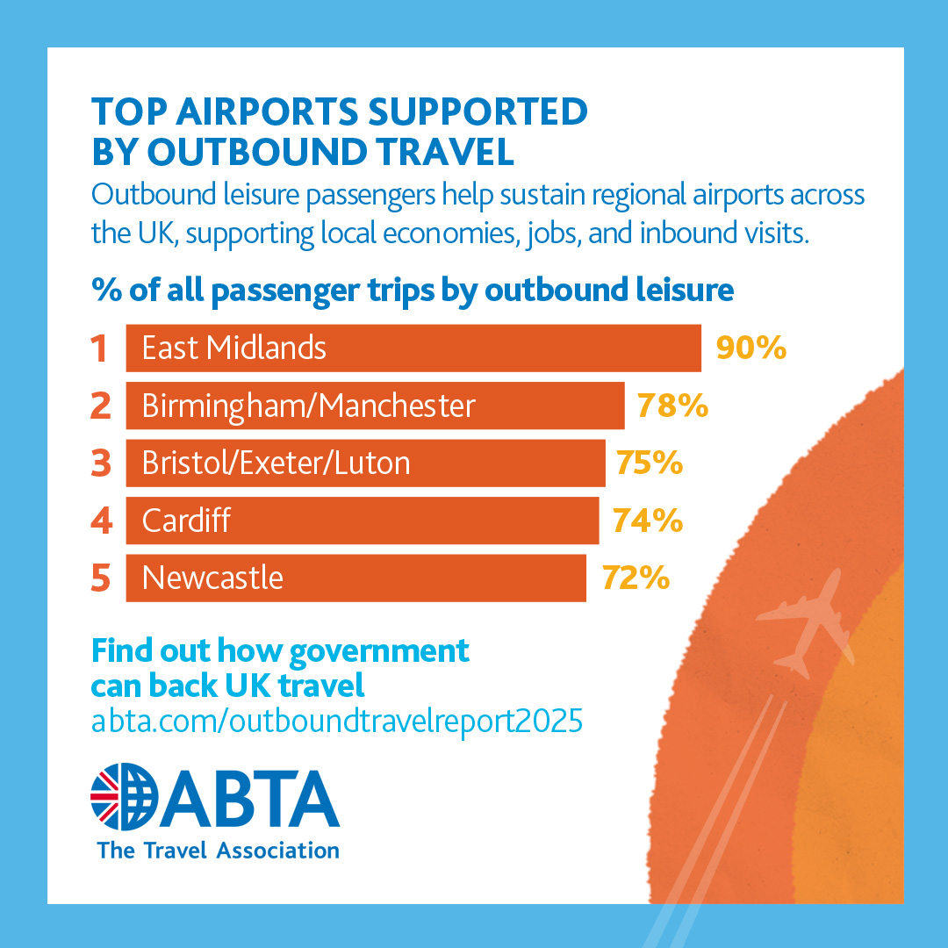
UK Travel Industry Economic Contribution
Notes:
You can download and share the full report from here: Outbound travel – a catalyst for jobs, growth and wellbeing | ABTA
ABTA’s latest report on the importance of UK travel demonstrates the vibrancy, resilience and fundamental strength of the industry –
Graphic 1: Outbound travel now contributes more than £52bn in Gross Value Added annually, which is the equivalent of 2.1% of GDP (Gross Domestic Product)
Graphic 2: And it supports a total of 818,000 jobs across the UK.
Our sector has the opportunity to deliver 20% growth by 2030 – making it worth £62bn a year to the UK economy, up from its current £52bn
Graphic 3: It also helps with the Government’s mission to create jobs and economic opportunity across the UK’s towns and cities.
For example, regional airports are particularly dependent on outbound leisure passengers for their success; East Midlands (90%), Manchester (78%), Birmingham (78%), Bristol (75%), and Exeter (75%).

Slide 7


Slide 8
What does ABTA do?
The Travel Association

Slide 9

About ABTA
Notes:
ABTA is the trade association for UK travel agents, tour operators and the wider travel industry.
For over 75 years they’ve helped their members run successful travel businesses, and provided travellers with advice, guidance and support.
They work closely with their members to help raise and maintain standards and build a more sustainable travel industry.
Whether it’s for business, a holiday or to see family and friends, you can relax and enjoy your trip when you book with an ABTA member.
ABTA and its members understand that every trip’s important, meaning you deserve great service, delivered by people you can trust. All ABTA members sign up to a code of conduct and commit to agreed service standards, accurate advertising and fair trading.
When people need clear travel information, and accurate and impartial advice relating to your trip, ABTA is there for them.
Their experts work with UK and overseas governments, and members, to make sure that information is current and accurate.
They help travellers understand their level of financial protection, and what to do next, in the unlikely event that an ABTA member goes out of business. So whatever happens, when people book with an ABTA member, reliable advice comes as standard.
This means that booking with our members gives peace of mind. If something goes wrong with a booking with a current ABTA member, people can turn to ABTA.
They can help resolve issues quickly and fairly with their complaints resolution process or, if necessary, their independent arbitration service. Together with their members, they help people Travel with confidence.

Slide 10

About ABTA
Notes:
Click image to play – ensure connected to internet/wi-fi

Slide 11
Career options in the travel industry
What jobs could I do?

Slide 12
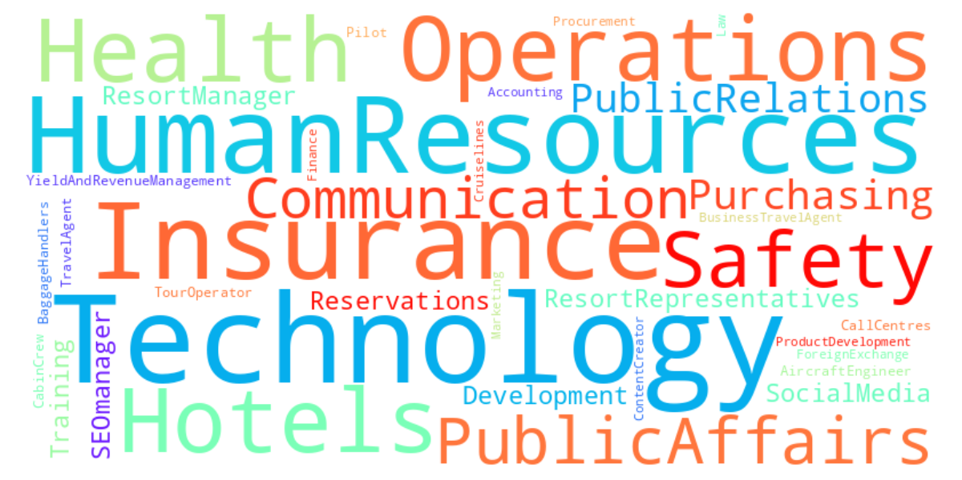
Careers in the travel industry
Notes:
Careers in the travel industry are diverse, but options could include:
Travel agent​, Tour Operator, Call centres, Pilot​, Cabin crew​, Aircraft Engineer​, Baggage handlers​, Product development, Marketing, Procurement , Content creator​, Business travel agent, Cruise lines, Finance and accounting, Law​, Foreign exchange, ​Technology, Human Resources​, Insurance​, Operations, Hotels​, Health and safety, Public Affairs, Communication, Purchasing, Public Relations, Resort Representatives , Resort manager, Reservations, Front of house, SEO manager​, Social media, Training and development, Yield and revenue management ​

Slide 13
Why work in the travel industry?

Slide 14

Why work in the travel industry
Notes:
If you’re interested in starting a career in travel, ABTA can point you in the right direction
The travel industry is an exciting place to be and opens doors to a wide range of possibilities.
It offers the chance to be part of a sector which takes people on holiday, helps business travellers to connect, and reunites friends and families. Behind every journey is a team of passionate people making it happen and you could join them.
The video was filled after ABTA's Convention in Marrakech in 2022. Click play icon to watch video on YouTube.
Use this second link to download any assets from ABTA BePartOfTravel marketing toolkit: https://www.abta.com/member-zone/running-your-business/abta-marketing-toolkit/bepartoftravel-marketing-toolkit

Slide 15


Slide 16
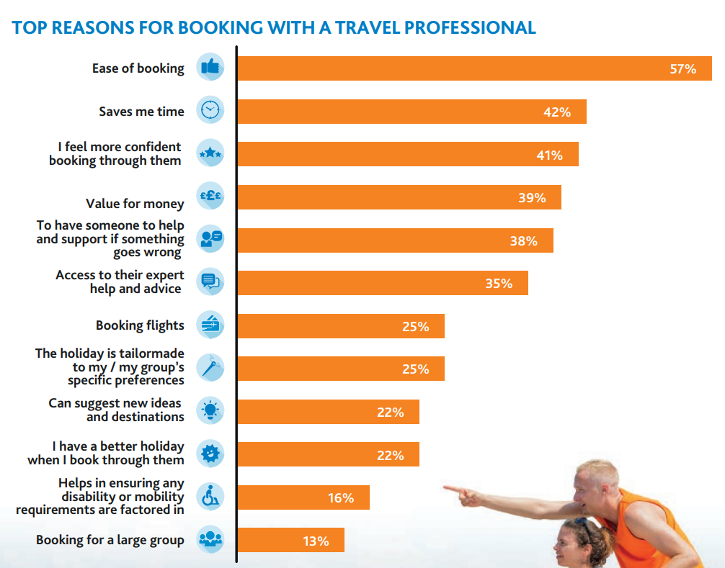
Notes:
Working as a travel professional and advisor continues to be an economically viable career choice.
We continue to see more people choose to book through a travel professional, according to research ABTA conducted.
The reassurance and expertise that customers get when booking with a travel company are highly sought-after.

Slide 17
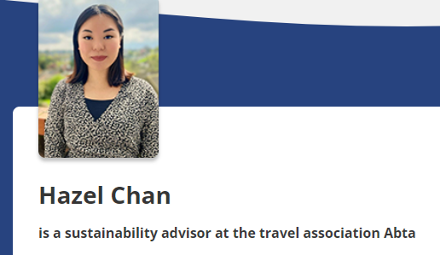
Sustainability careers in travel
“My journey began right after university – I’ve always had a keen interest in sustainability, and I saw an opportunity to champion it within the travel sector. I wanted to make a positive impact on local communities.
A big challenge is the sheer size of the supply chain, wide and diverse from tracking carbon emissions to dealing with ethical concerns and managing resource use.”

Slide 18
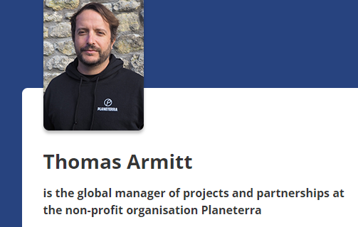
Projects and partnerships careers in travel
“We work with community-led enterprises to develop their business skills and products, address social, economic and environmental issues. We partner with travel companies to uplift women, youth and indigenous people, improve food and water security, champion rights and safeguard cultures.
My role leads global climate and biodiversity crisis response, to integrate adaptability and resilience into tourism initiatives.
I’ve worked in responsible and sustainable tourism for 16 years, since my third year on university I spent in Senegal, researching community-based ecotourism.
My journey has taken me to Sierra Leone, Benin, Haiti, Brazil, Chad, Cabo Verde, Croatia, Vietnam and Peru, working alongside private, public and third sector organisations to create and implement responsible and sustainable tourism models.”

Slide 19
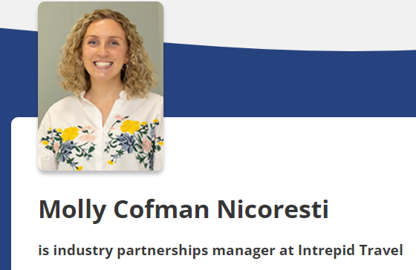
Industry partnerships careers in travel
“After graduating university where I studied history and classics, I spent 5 months in South America. On return I applied for a role with Latin Routes and got the role.
My favourite part was building relationships across the UK, the independence of being ‘on the road’ and hosting 50 agents on a trip to Rio de Janeiro.
My current role is at Intrepid Travel which always stood out to me for their incredible trips, but also their sustainability credentials and belief that positive change can be made through the joy of travel.
Looking back, I’m glad I took that trip to South America and followed my own path, it’s taken me around the world and led me to a fantastic and fulfilling career.”

Slide 20
Education and
Career Development

Slide 21
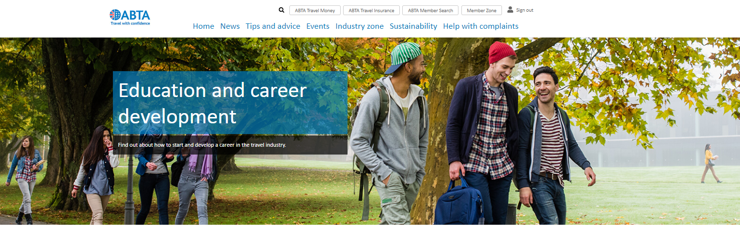
Education and career development
Notes:
ABTA provides a wealth of advice and guidance on pursuing education and careers in the travel industry
Visit their website for education and career inspiration at https://www.abta.com/industry-zone/education-and-career-development/careers-in-travel
The travel industry offers a wide range of career opportunities.
It is this range of opportunities and the freedom to explore different paths that attracts and keeps so many great people in this fantastic industry.
As the UK’s largest travel trade association, ABTA is well-positioned to facilitate relationships between education providers who are developing employees of the future, their Members, who are seeking to employ skilled and educated staff, and the wider travel industry.
They work closely with their Members and educators to understand the skills needed to support career development and they offer a range of learning opportunities to support this development through ABTA’s Conferences and Events programme, as well as by facilitating links with education partners.
ABTA’s Education Partner scheme is aimed at bringing universities, colleges and training companies closer to Members.

Slide 22

Education and career development
The ABTA ‘Knowledge Zone’
Notes:
The ABTA Knowledge Zone is ABTA’s online training portal.
All about ABTA section is freely available for anyone to explore.
The rest of the training is only available to ABTA members and ABTA Education Partners.

Slide 23
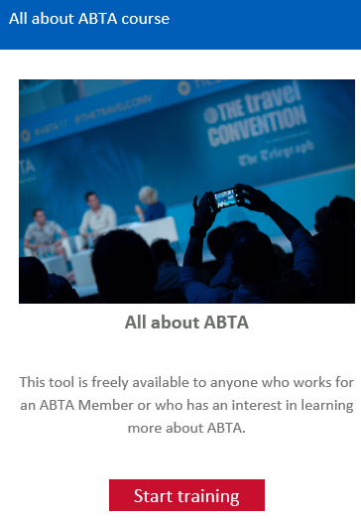
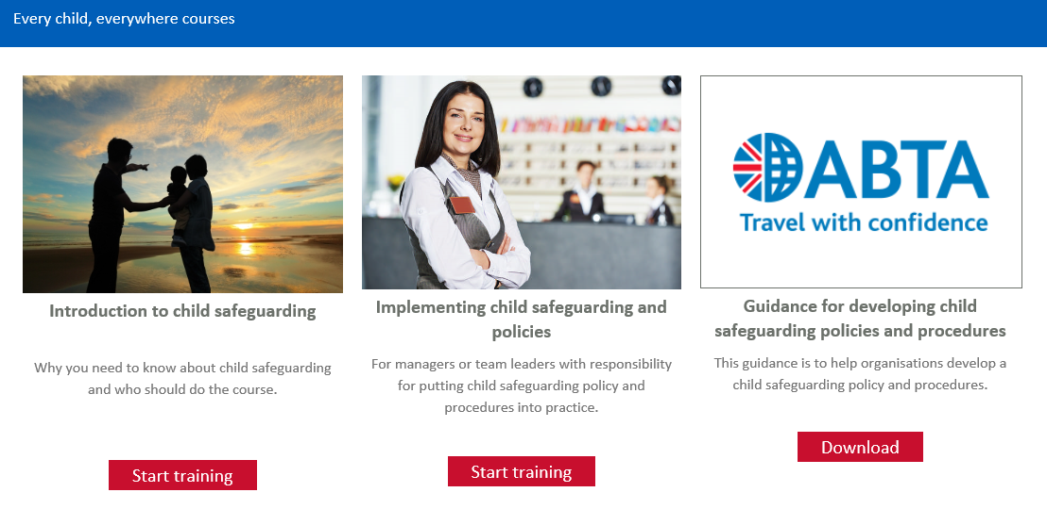
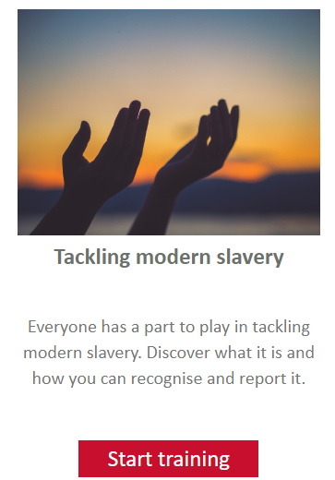
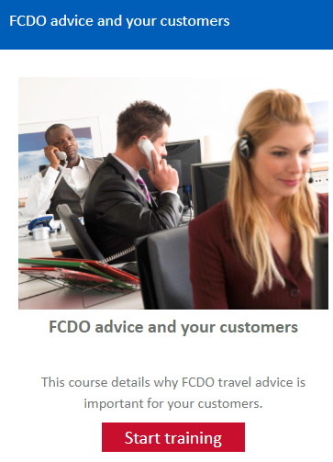
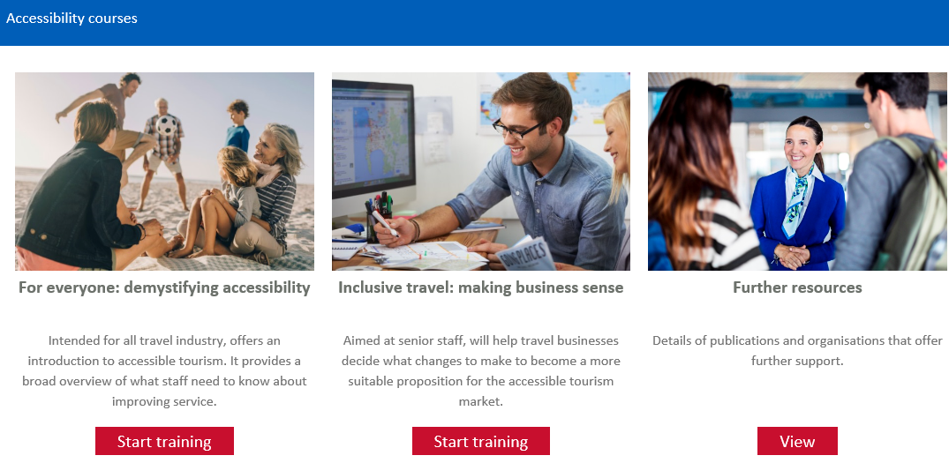
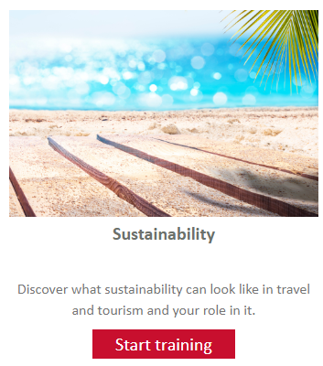
Education and career development
Free training courses for ABTA members and Education Partners

Slide 24
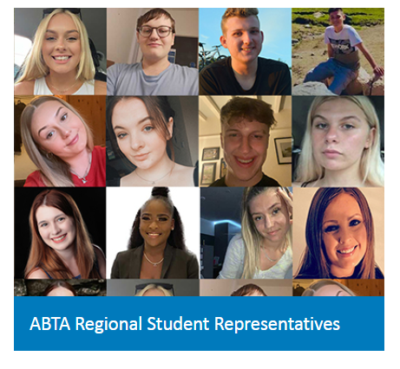
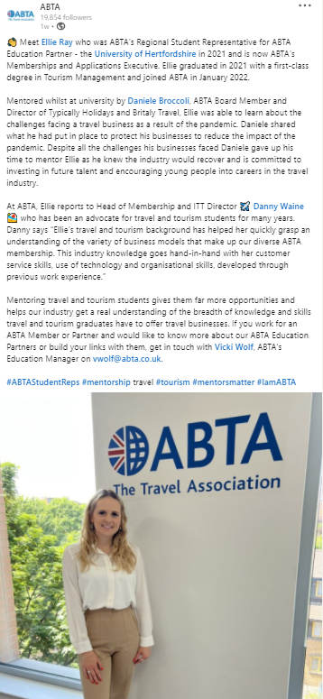
ABTA Student Reps
Notes:
ABTA offers an online mentoring programme to our ABTA Student Reps who are appointed by each ABTA Education Partner.
This links students with an industry expert to learn more about the travel industry.
It also helps the industry to get a better understanding of the type of issues covered in travel and tourism courses.
If you’d (college/school/university), would like to find out more about becoming an ABTA Education Partner, please contact Vicki Wolf at ABTA (vwolf@abta.co.uk)

Slide 25












Universities and colleges working with ABTA
Notes:
Universities and colleges working with ABTA
ABTA works very closely with universities and colleges who join our ABTA Education Partner scheme.
These universities and colleges can attend ABTA’s twice-yearly regional meetings and meet ABTA Members in their area.
They have exclusive access to ABTA’s vast industry resources and expertise through the Member zone of ABTA’s website and via regular communications from ABTA, as well as attending ABTA events.
ABTA Education Partners receive an annual guest lecture from ABTA’s team of experts and university Partners have the exclusive opportunity for their students to apply for ABTA’s annual internship.
ABTA's internship
At ABTA we encourage our Members to take on interns, graduates and work placements wherever possible.
ABTA offers a one month, paid internship (at the London Living Wage rate) to one student from an ABTA Education Partner University annually. The successful candidate will work within one of ABTA’s team for a month working on live issues as well as conducting research on behalf of ABTA. Previous interns have worked in the Travelife sustainability team and the ABTA Communications team.
Students at ABTA Partner Universities can apply the next ABTA Internship through their course leaders. Applications close in early March. If you aren’t sure who to contact at your university, please contact Vicki Wolf on vwolf@abta.co.uk. Your university must be an ABTA Education Partner in order to apply.
Students from any year at ABTA Partner Universities are invited to apply and we’ve had from first year to masters students as our interns.

Slide 26



Apprenticeships
Opportunities
Notes:
Apprenticeships in the travel industry
If you are interested in starting a career in travel, or in broadening your skills as you develop your career, an apprenticeship is a great option. Many travel companies offer schemes providing a variety of different routes. ABTA works with industry representatives as part of the Travel Consultant Trailblazers Group.
This group developed professional standards for Travel Consultant Apprentices. This apprenticeship has an end assessment test, ensuring that every apprentice needs to meet the agreed industry professional standards. These standards are regularly reviewed by industry and Government.
The Travel Consultant Apprenticeship covers both leisure and business travel.
You can find out more about a wide range of apprenticeships through the Government apprenticeship website skillsforcareers.gov.uk
Many training providers and colleges also offer the travel apprenticeship.
A growing number of ABTA members offer apprenticeships in several other areas too, such as a range of aviation-related apprenticeships, human resources, digital marketing and IT. The range of careers in travel companies can be vast and the range of opportunities is varied.
If you are looking for an apprenticeship, the Government apprenticeship website has a wealth of information to assist you.
Many ABTA Members recruit apprentices directly through their website and Facebook pages; so be sure to check those out.

Slide 27

Education & Training
ABTA is represented on the Institute of Travel and Tourism’s Education and Training Committee. The ITT offers student membership, as well as networking opportunities for students and graduates.
ITT Education & Training Hub
ITT Future You initiative
Notes:
Useful resources for students studying travel and tourism-related courses include the ITT Education & Training Hub and the ITT Future You initiative; which organises inspiring careers in travel events across the UK each year.

Slide 28






Ways to find a job in travel
Notes:
Travel company career pages to find out about job opportunities and their company culture to see if your experience would be a good fit.
Set up LinkedIn alerts for travel companies that you would like to work for so you can be among the first to apply.
Contact travel recruitment specialists – such as C&M Recruitment or Travel Trade Recruitment.
Indeed.com and its travel industry jobs board.
Register with travel industry trade news sites Travel Weekly and TTG Media as they often share the latest opportunities and information about working in travel.

Slide 29

www.takeoffintravel.co.uk
Notes:
ABTA supports an annual career guide Take off in Travel which is produced by trade publication Travel Weekly. (click link to show website)
This gives an excellent overview of the range of careers in the travel industry. Various routes to entry are discussed and it includes a range of career case studies. You’ll also find contact details for universities, colleges and companies with opportunities in the travel industry.
The website gives you a taste of a truly global sector and has been produced with the support of ABTA and the Institute of Travel & Tourism’s Future You Foundation and the headline sponsor Hays Travel.
You can find out more about the industry and job opportunities within it, as well as ways to start on your career journey and a range of travel companies waiting to help you take your first step.

Slide 30


Slide 31
Resources for students

Slide 32
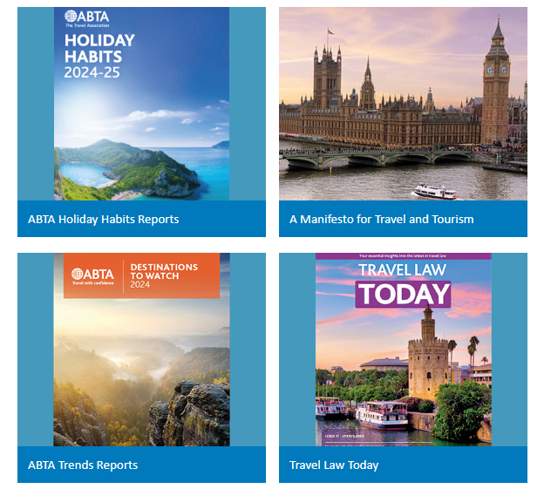
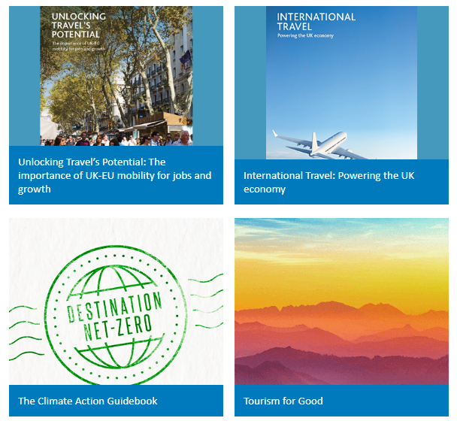
Travel Industry Reports & Publications | Travel & Tourism Trends | ABTA
Notes:
ABTA provides dozens of reports and publications. Lots of travel lecturers, as well as students regularly use these resources in their lectures and studies.
These are free to access on the ABTA website
Travel Trends
Destinations to watch
Climate change reports
Travel Law
Jobs and growth in tourism and much more

Slide 33
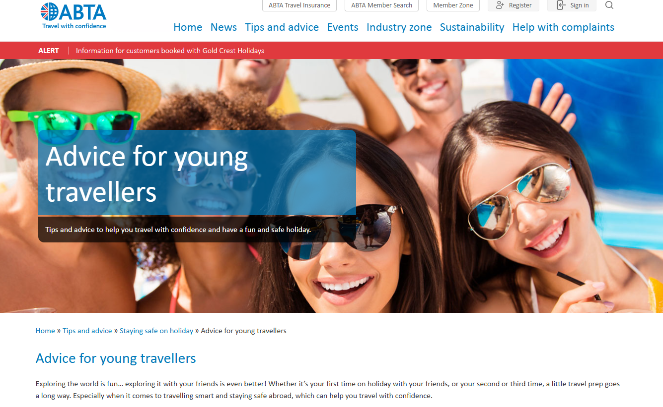

Notes:
ABTA and its members work with the Foreign, Commonwealth, Development Office (FCDO) to ensure practical and emergency travel advice is communicated to travellers. Their Travel Aware campaign is consumer facing.

Slide 34

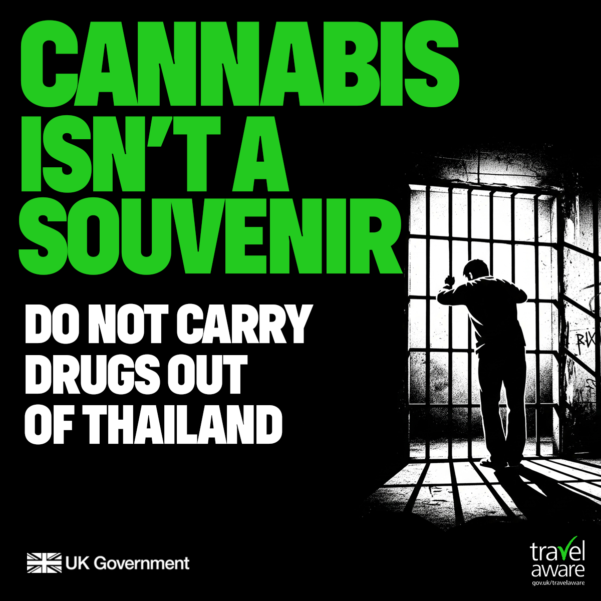

Drug Awareness
Notes:
The FCDO and NCA have noted a sharp increase in drug smuggling arrests among British Nationals (BNs), both abroad and in the UK. The majority of arrests are linked to cannabis originating from Thailand.
This follows the decriminalisation of cannabis in Thailand in 2022.
There is a serious risk of coercion by organised crime groups to BNs. Several have been offered money in exchange for carrying bags through customs.
Criminal gangs are known to pressure people into carrying drugs. Always pack your own luggage and do not carry anything through customs for someone else.
Foreign legal systems have varying penalties for cannabis possession. British nationals caught carrying cannabis could be faced with lengthy prison sentences and in some countries, the death penalty.
That is why our advice is clear – do not carry cannabis out of Thailand.
Travel Aware campaign aims:
To reduce the number of preventable incidents involving British nationals abroad that require consular assistance. This reduces time and financial resource spentby the British Government.
To drive users to GOV.UK's foreign Travel Advice service and other relevant GOV.UK pages

Slide 35
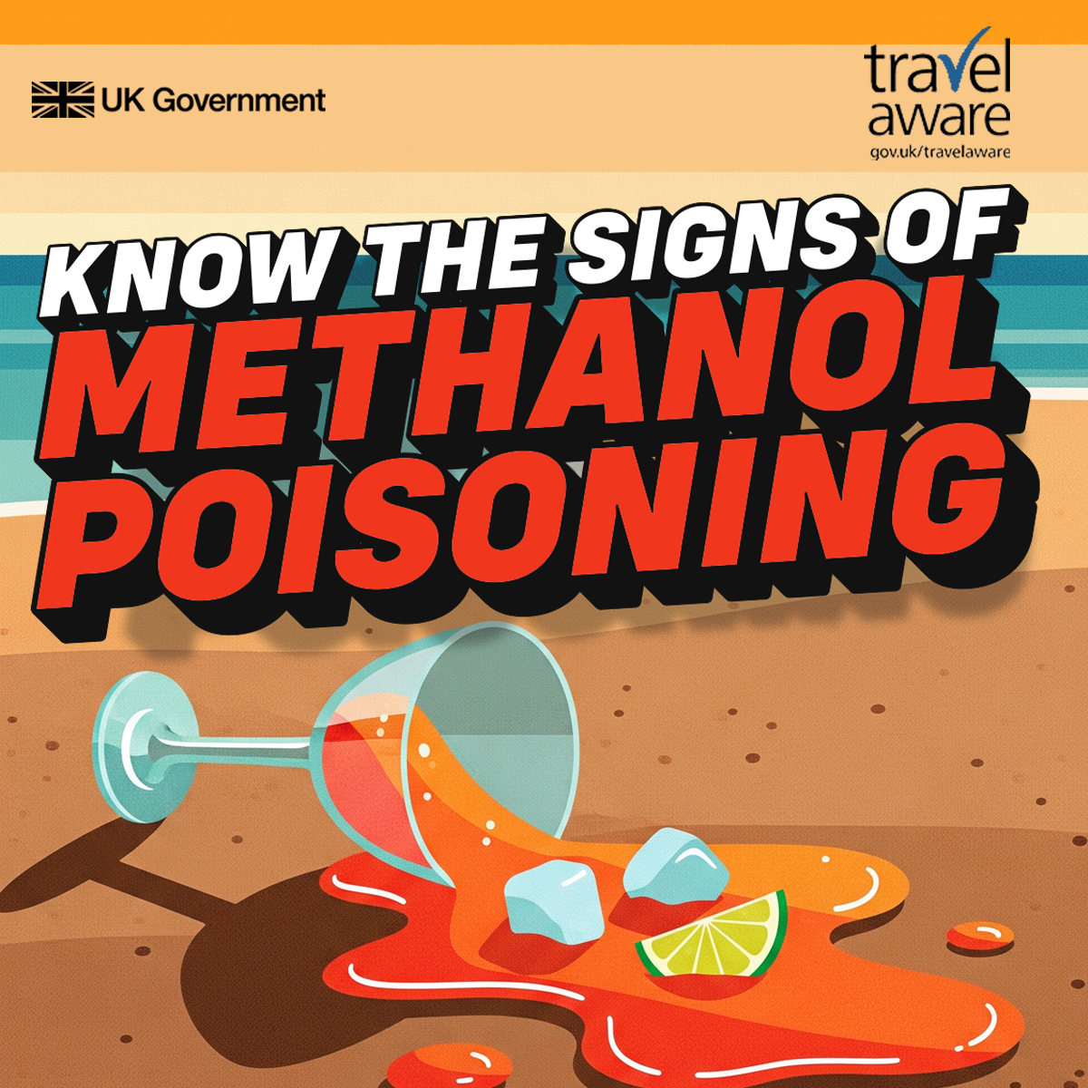
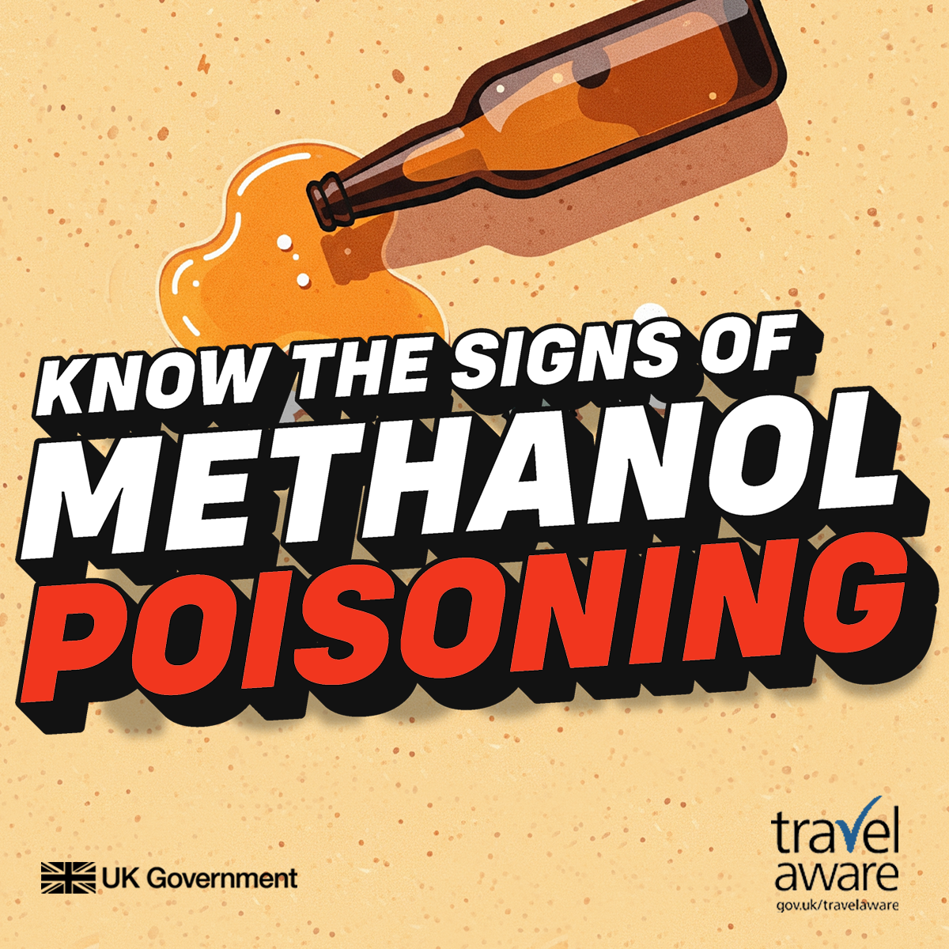
Methanol poisoning and counterfeit alcohol
Notes:
Methanol is toxic even in small amounts. It is an industrial alcohol made from distilling wood and can be found in many commercial products, like antifreeze, fuel and paint thinners. In some parts of the world methanol products are sometimes illegally mixed with ‘real’ alcohol such as spirit-based drinks and cocktails.
Medical experts believe that as little as 30ml (roughly equivalent to a shot) of methanol can be fatal for an adult, while 10ml can cause blindness.
How to spot the signs of methanol poisoning
Spotting methanol poisoning can be difficult because at first it can affect you in the same ways as ‘real’ alcohol. Some early symptoms – like vomiting – can seem like a bad hangover. But travellers should watch out for a hangover that feels worse than it should. Signs to watch for:
Early signs: vomiting, poor judgement, loss of balance and drowsiness.
12-48 hours after drinking: abdominal pain, vertigo, hyperventilation, breathlessness, blurred vision and/or blindness, coma and convulsions. If you or someone you are travelling with have any of these symptoms seek urgent medical attention.
Vision issues are a red flag and can also appear 12-48 hours after the first drink. Methanol poisoning can cause blurry vision, trouble looking at bright lights, and in some cases complete blindness. “Snowfield vision” (seeing snowy static like an old TV) or tunnel vision can also occur. If you have any of these symptoms, seek urgent medical help.
Urgent medical attention could save your life or prevent serious complications.
How to reduce the risk of methanol poisoning
It is not possible to completely remove the risks from methanol poisoning when drinking alcohol but you can take steps to reduce the risk:
Avoid free cocktails or shots, unlabeled bottles and unusually cheap or discounted drinks claiming to be brand name alcohol.
Be careful about spirit-based drinks such as those ‘on the rocks’, shots, cocktails, buckets or jugs.
Choose branded beers, ciders, wines and premixed cocktails in sealed bottles and cans.
Stick to licensed places: buy drinks from licensed stores, bars, clubs, restaurants and hotels. Avoid homemade, ‘bootleg’ or streetside alcohol.

